Slide 1
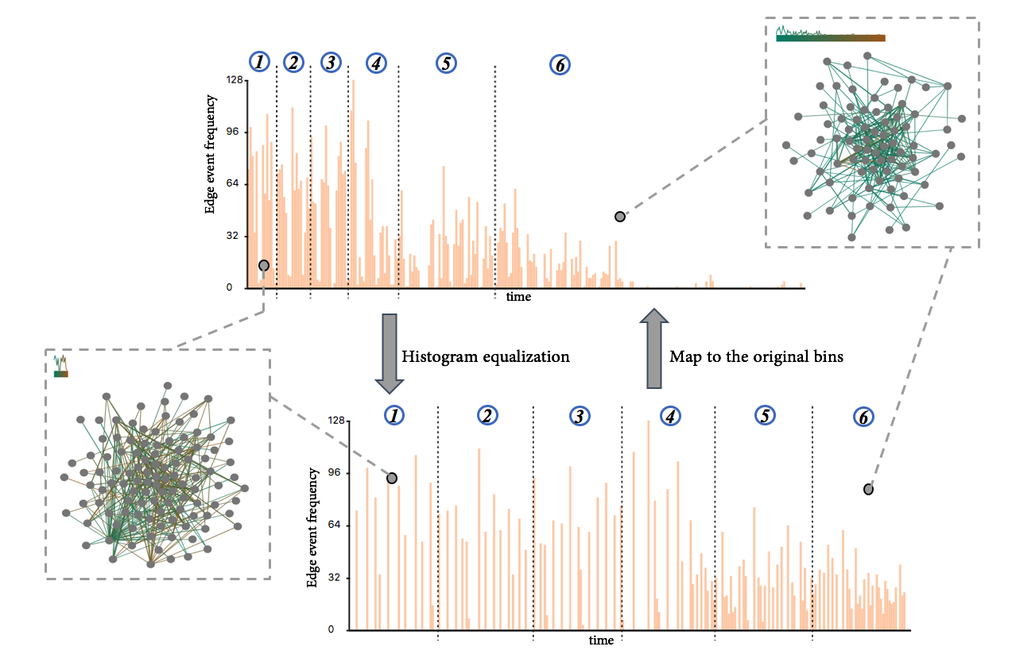




Nonuniform Timeslicing of Dynamic Graphs Based on Visual Complexity
Yong Wang¹, Daniel Archambault², Hammad Haleem¹, Yanhong Wu³, Torsten Moeller⁴, Huamin Qu¹
http://yong-wang.org/proj/nu_timeslicing.html
1
2
3
4
Notes:
Hello, everyone, welcome to my talk.

Slide 2
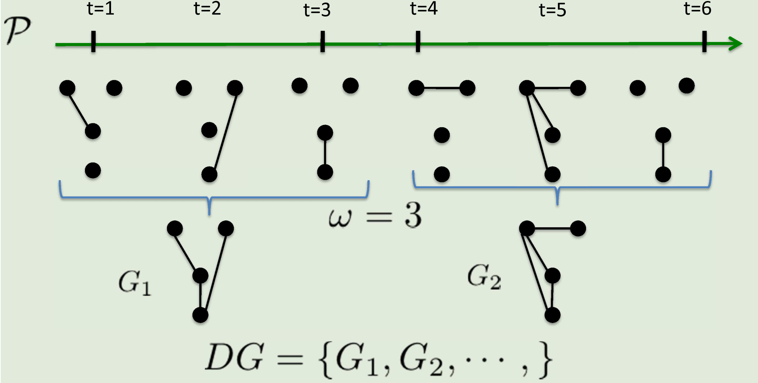
Background
A dynamic graph is a sequence of graph snapshots defined over an edge stream
Uniform timeslicing divides time into equal intervals and is usually used in dynamic graph visualization for convenience and simplicity

Slide 3
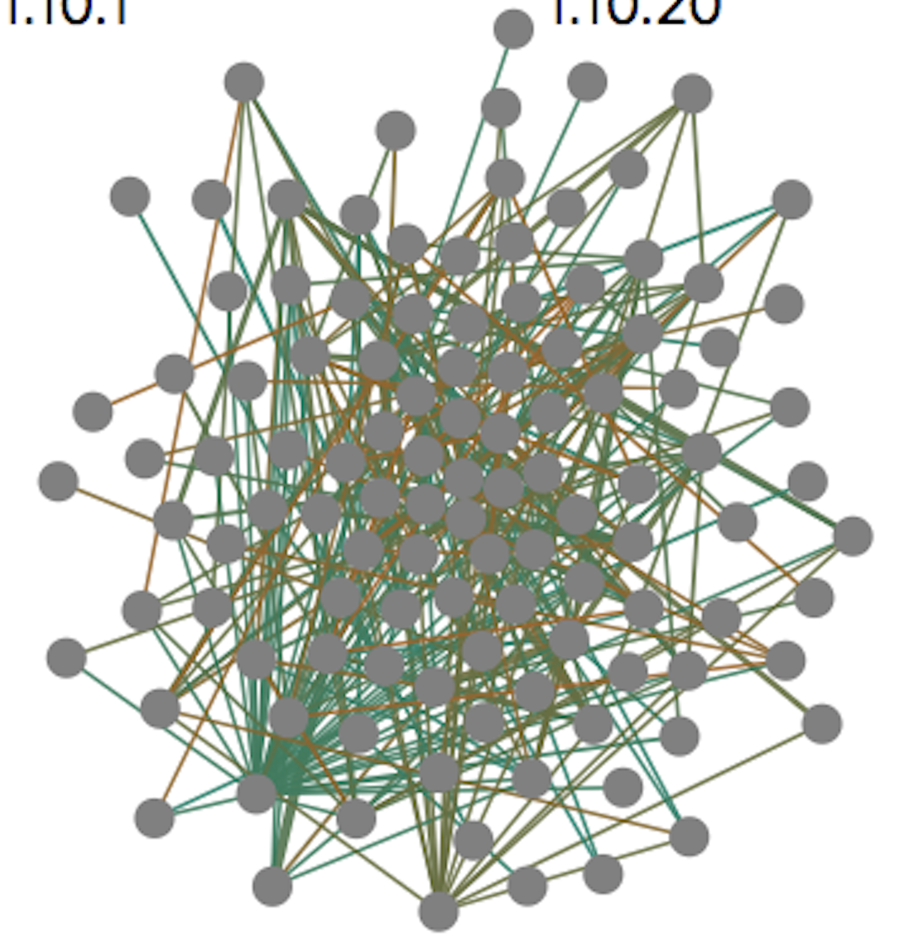
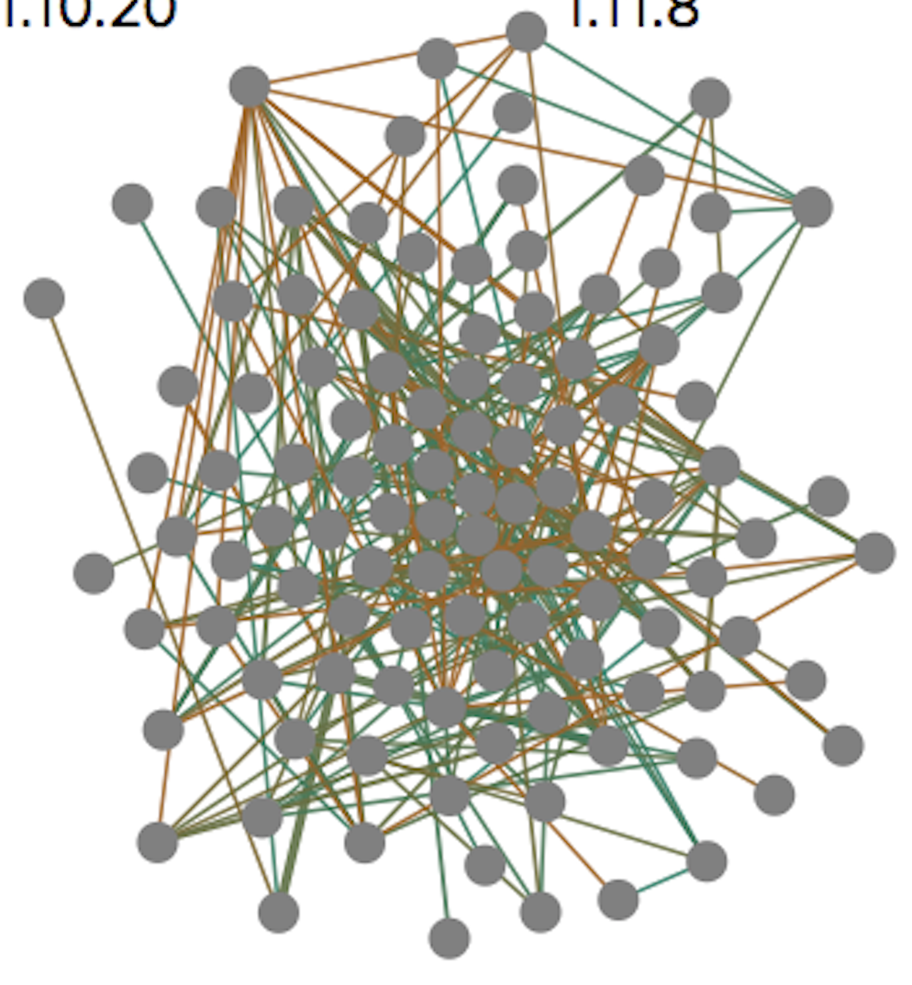
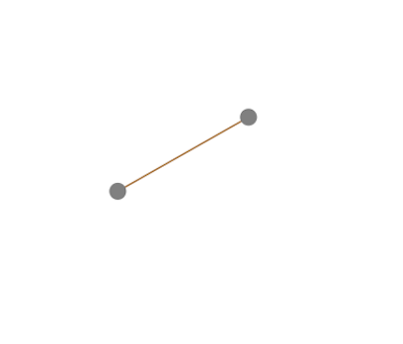
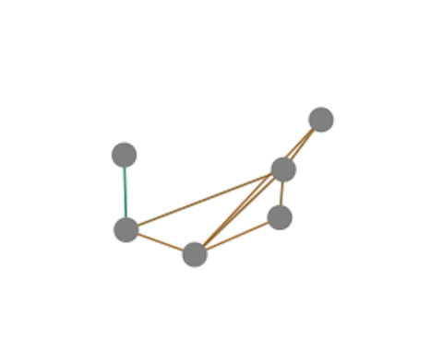
Background
For dynamic graph visualization, uniform timeslicing:
- Does not take the data into account
- Can generate cluttered timeslices with bursting edges, and empty timeslices with few edges
Notes:
However, when using uniform timeslicing for dynamic graph visualization, it does not take the data into account. Thus, it can generate 【tick】 cluttered time-slicings with ….. 【Tick】
Given the limited budget of the number of time intervals. It often hinders users from fully exploring the details of dynamic graphs.

Slide 4
Research Problem
How can we make full use of the limited number of timeslices to show more meaningful information?
How can we provide users with better perception of the dynamic graph (especially the periods with bursting edges)?

Slide 5
Nonuniform Timeslicing
Goal: create timeslices of similar visual complexity
A simple definition of visual complexity: number of edges
Notes:
In this paper, we propose a nonuniform timeslicng approach to create timeslices of similar visual complexity, instead of timeslices with equal time range.
Here, we use a simple definition of visual complexity for graphs: the number of edges,

Slide 6
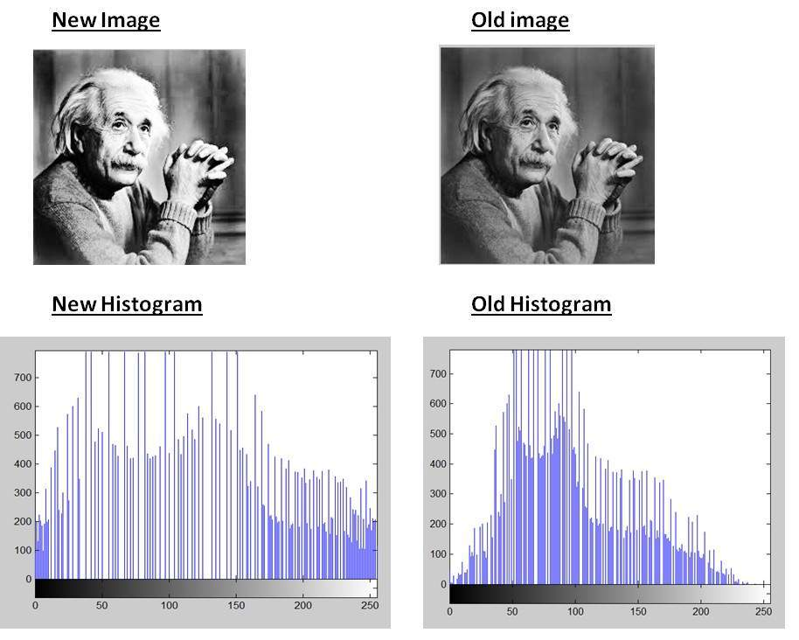
Nonuniform Timeslicing
Solution: nonuniform timeslicing based on histogram equalization, a technique for enhancing image contrast
https://www.tutorialspoint.com/dip/histogram_equalization.htm
Notes:
Specifically, our nonuniform timeslicing approach is mainly based on histogram equalization, a classical technique for enhancing image contrast.
As you can see, the right figure is a bit darker and its color bins have the highest frequencies in the range between 【Tick】
50 to 100. After applying histogram equalization 【Tick】
to re-distributing the color bins, the overall color contrast of the image is enhanced.

Slide 7
Nonuniform Timeslicing
Image contrast enhancement vs. dynamic graph visualization
Image Contrast Enhancement | Dynamic Graph Visualization
Low color contrast | Visual clutter in some timeslices
Color convergence in certain color range | Edge bursting in certain time range
Re-distribute color bins for equal distribution
Problems
Causes
Solutions
How ???
Notes:
When working on this research project, we found that Image contrast enhancement and timeslicing of dynamic graph visualization share some similarities.
For example, the low color contrast of images is due to the color convergence in certain color range. While the visual clutter in timeslices of dynamic graphs is due to the bursting edges in some timeslices.
The solution for image contrast is to re-distribute color bins for equal distribution.

Slide 8
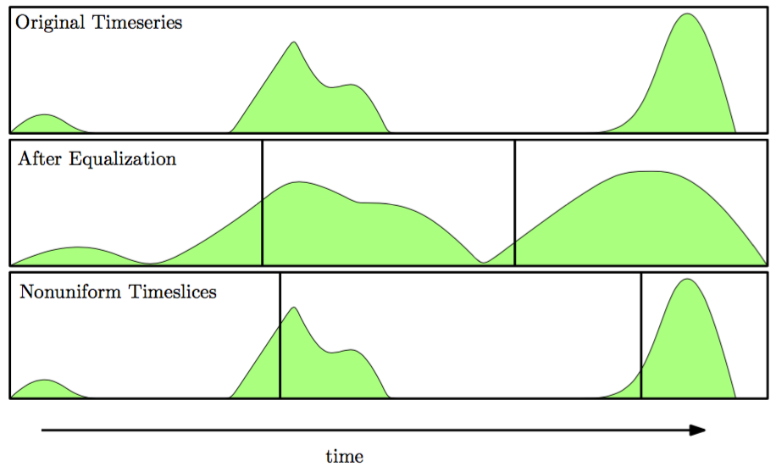
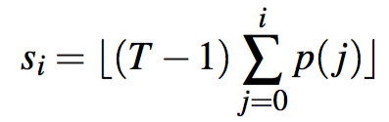
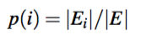
Nonuniform Timeslicing For Dynamic Graphs
Adapt histogram equalization to redistribute edge counts across time
For the i-th bin in the original time series, histogram equalization will transform it to the following bin:
Where , T is the total time range, $E_{i}$ is the number of edge events in the i-th bin and $E$ is the total number of edge events.

Slide 9
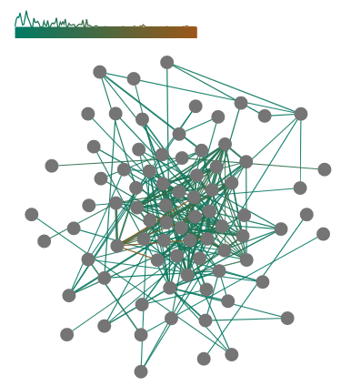
Nonuniform Timeslicing For Dynamic Graphs
Visual hint for time information
- An explicit time legend for each graph snapshot
Notes:
However, one of the potential issue of the nonuniform timeslicng for dynamic graph visualization is that it may cause trouble to track the time length of each time interval.
So 【Tick】we design a explicit time legend for each graph snapshot, where a blue to red color range indicates the time and a line-chart is integrated into it to show the edge frequencies.

Slide 10
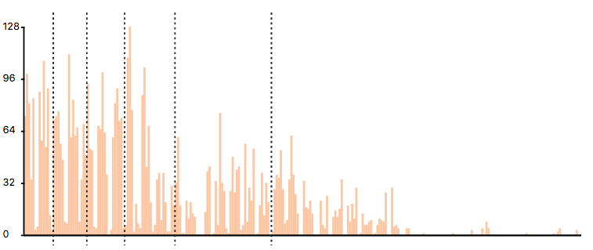
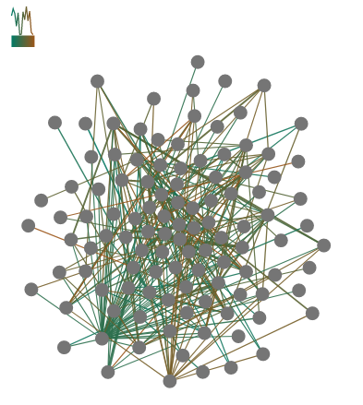
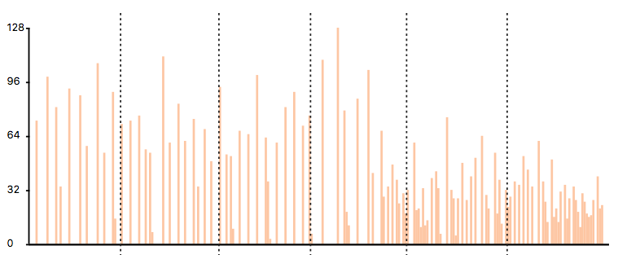
Nonuniform Timeslicing For Dynamic Graphs
1
2
3
4
5
6
One example
Edge event frequency
time
Histogram equalization
Map to the original bins
1
2
3
4
5
6
Edge event frequency
time

Slide 11
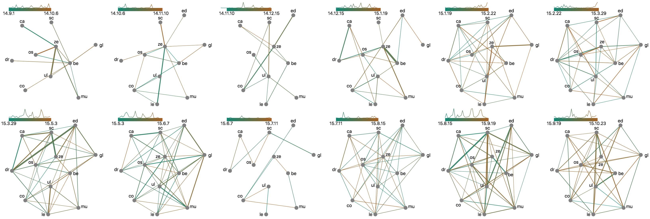
Evaluation – Qualitative Case Study
Rugby dataset --- uniform timeslicing
1
2
3
4
5
6
7
8
9
10
11
12
- Intervals1, 2, 3, 9: sparse edges
- Intervals 11, 12: dense edges, hindering users from checking details
https://arxiv.org/abs/1709.00372
Notes:
We conducted qualitative case studies on the Rugby dataset. This dataset shows the twitter interactions between several rugby teams in 2015 in UK.
As shown in the figure, the uniform timeslicing equally divides the whole time range. But from the result, we can easily see that 【Tick】
Intervals 1, 2, 3, 9 have very sparse edges while 【Tick】
intervals 11, 12 have very dense edges, hindering users from checking the details within them.

Slide 12
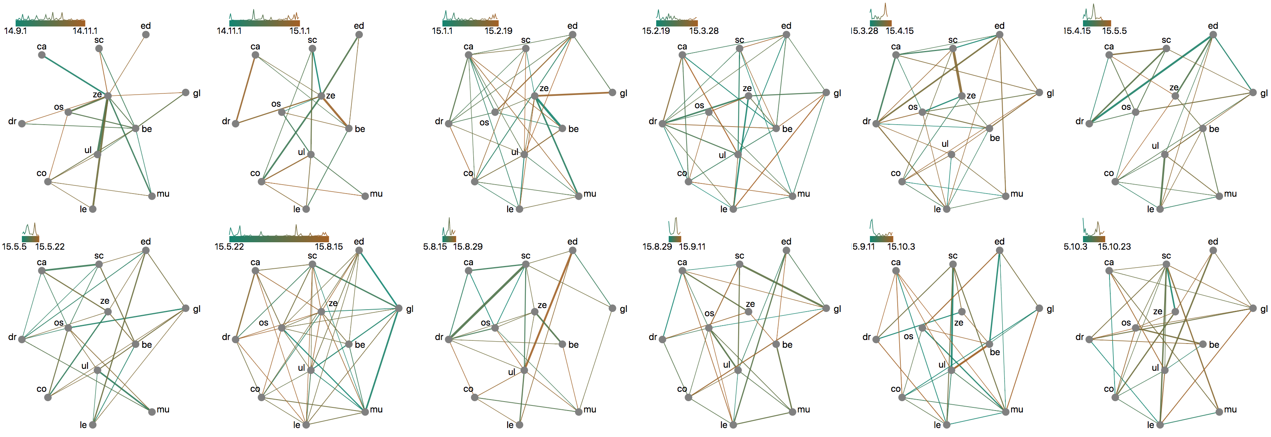
Evaluation – Qualitative Case Study
Rugby dataset --- nonuniform timeslicing
1
2
3
4
5
6
7
8
9
10
11
12
- Intervals 8: sparse interactions (summer break from may to August)
- Intervals 9-12: dense interactions (the season begins)
- Reveal more details: “sc” interacted most with different teams along time
Notes:
On the contrast, if we applied our nonuniform timeslicing approach to visualize the Rugby dataset.
We can see more balanced visual complexity across time intervals. By further checking the length of the time legend, it is easy to find that【Tick】
Interval 8 covers a long time range, which indicates the sparse interactions among different rugby teams in summer break from may to August.
【Tick】
While Intervals 9 to 12 have dense interactions between different teams as the season begins.
Also, 【Tick】
nonuniform timeslicing can reveal more details of the time with dense edges. For example, the team “SC” (or Scarlets_rugby) intensely interacts with different teams along time.
But such kind of details are really difficult to be observed in the results of uniform timeslicing.
=======
SC or Scarlets team interacts most with ”DR” (Dragon_rugby) in August, 2015, then switched to “GL” (Glasgow rugby) team in early September and further interacted most with “UL” (ulsterrugby) in late September. But such kind of details are really difficult to be observed in the results of uniform timeslicing.
==============================
the sparse interactions within it.
(reveal the finals)
Easy to recognize the overall trend of interactions between Rugby teams:
The time legend indicates the overall trend of interaction frequency between Rugby teams
Corresponds to the games/fixatures

Slide 13
Summary and Discussion
Compared with uniform timeslicing, the proposed nonuniform timeslicing can achieve
- Balance visual complexity across intervals
- Reveal more details in the intervals of bursting edges
Limitations
- Scalability issues: visual clutter can be reduced but cannot be always removed
- Application: more suitable for dynamic graphs with edge event variations

Slide 14
Nonuniform Timeslicing of Dynamic Graphs Based on Visual Complexity
Yong Wang¹, Daniel Archambault², Hammad Haleem¹, Yanhong Wu³, Torsten Moeller⁴, Huamin Qu¹
http://yong-wang.org/proj/nu_timeslicing.html
1
2
3
4

